Slide 1
Classification of Diabetes Health Indicators
Submitted in the partial fulfillment for the award of the degree of
BACHELOR OF ENGINEERING
IN
Artificial Intelligence & Machine Learning
Submitted by:
Aryan Kushwaha (20BCS6691)
Ankith Raj (20BCS6684)
Vaibhav Kumar Singh (20BCS3842)
Aryan Gupta (20BCS6656)
Under the Supervision of:
Dr. Amit Vajpayee(E14118)
DISCOVER . LEARN . EMPOWER

Slide 2
Outline
Sr.no | Title
1 | Introduction to Project
2 | Why Opted this project?
3 | Problem Formulation
4 | Objectives of the work
5 | Methodology used & Design Selection
6 | Analysis of Features
7 | Results and Outputs
8 | Conclusion
9 | Future Scope
10 | References
2

Slide 3
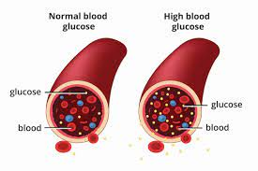
Introduction
Diabetes is a chronic health condition characterized by the body's inability to effectively convert food into energy.
It occurs when pancreas creates insulin in excess or unable to create insulin to meet the requirements.
In such cases body becomes deficit of insulin and diabetes occurs.
It results from either insufficient insulin production or the body's inability to use insulin properly.
Diabetes are divided into different types.

Slide 4
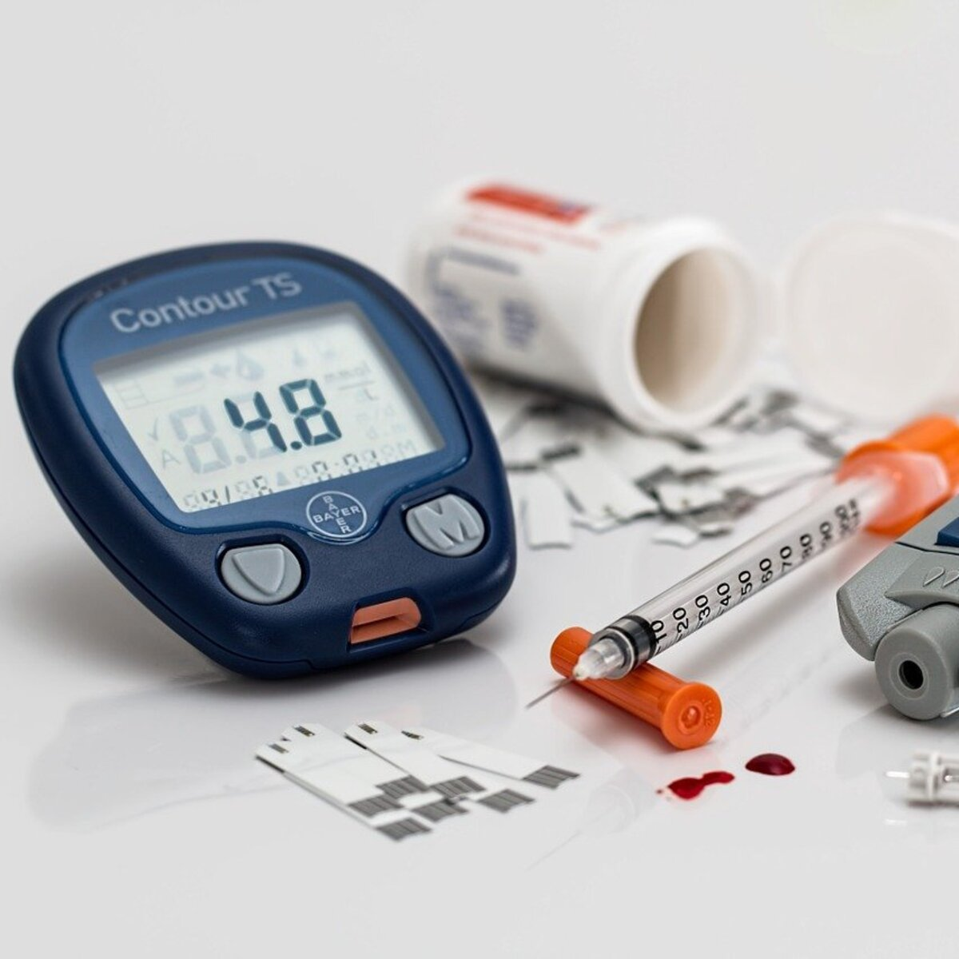
Why Opted this project?
Opting for a project on Understanding Diabetes Health Indicators is imperative due to its significant societal impact. Diabetes affects millions worldwide, with rising prevalence rates.
Understanding its types and indicators enables proactive health management and prevention strategies.
Moreover, educating individuals about diabetes fosters early detection, better management, and reduced complications.
By addressing this crucial health concern, we contribute to enhancing public health outcomes and quality of life.

Slide 5
Problem Formulation
Develop a classification model capable of accurately predicting diabetes status. Identify key health indicators that significantly contribute to diabetes classification. Optimize the model for sensitivity to ensure early detection of diabetes cases.
Evaluate the model's performance using appropriate metrics such as accuracy, precision, recall, and F1-score.Provide insights into the importance of various health indicators in diabetes classification.

Slide 6
Objective
In this project, the objective is to predict whether the patient has diabetes or not based on various features like Glucose level, Insulin, Age, BMI. Will perform all the steps from Data gathering to Model deployment.
During Model evaluation, compared various machine learning algorithms on the basis of accuracy score metric and find the best one. Then created a web app using Flask which is a python micro framework.
The goal is to promote early detection, effective management, and prevention of diabetes-related complications, leading to improved health outcomes for individuals and communities.

Slide 7
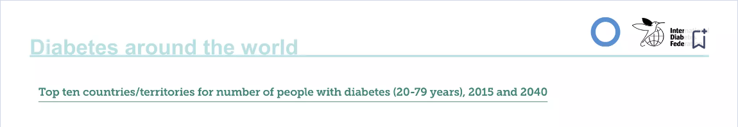
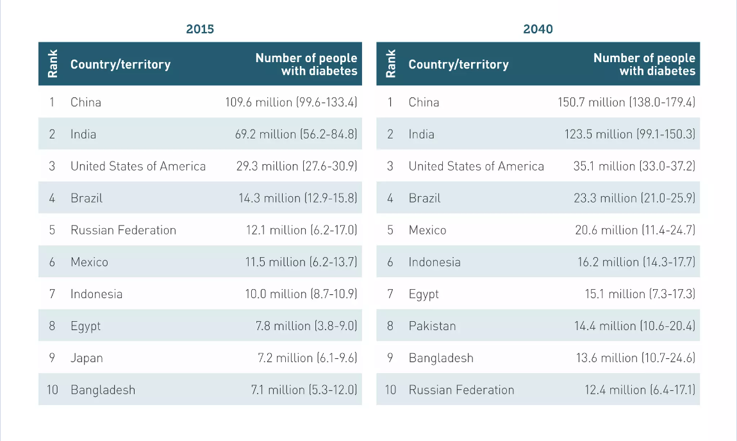

Slide 8
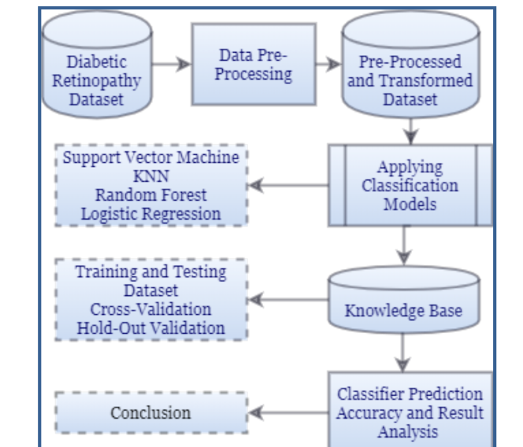
Preliminary Design

Slide 9
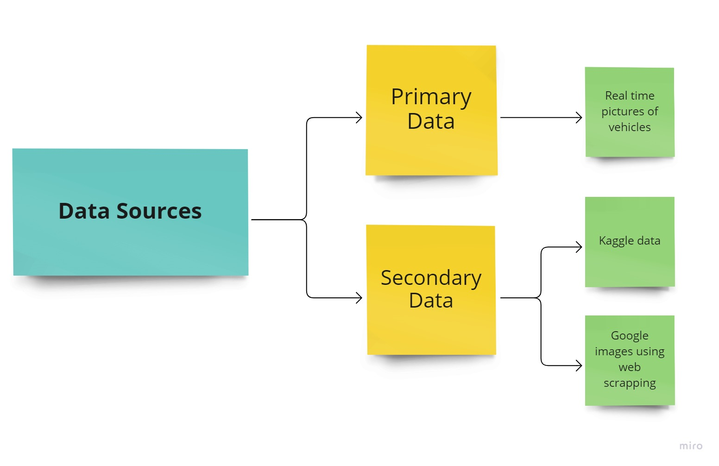
Methodology
Real data from diabetic patients
Kaggle data
Applying ML and DL algorithms

Slide 10
Methodology
The methodology for the diabetes prediction project involves data collection from reliable sources, including medical records and lifestyle factors. Preprocessing includes data cleaning and feature selection.
Model selection involves comparing algorithms like logistic regression, decision trees, and neural networks.
Evaluation metrics such as accuracy, precision, recall, and F1 score are used for model performance assessment.
Finally, the model undergoes validation and fine-tuning for optimal predictive accuracy.

Slide 11
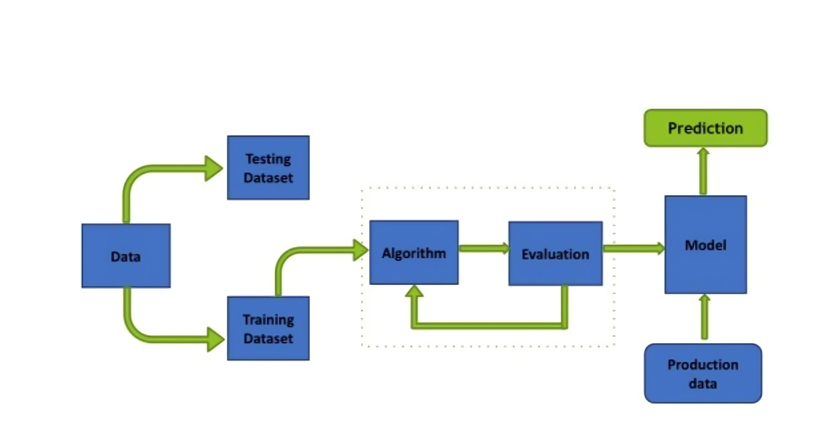
Block Diagram

Slide 12
Feature Analysis
Blood Glucose Levels: Fasting and postprandial glucose levels provide critical insights into glycemic control .
Insulin Resistance: Assessing the body's response to insulin helps in understanding diabetes progression.
Body Mass Index (BMI): BMI correlates with obesity, a major risk factor for type 2 diabetes.
Hemoglobin A1c (HbA1c): HbA1c reflects average blood glucose levels over the past 2-3 months, aiding in long-term monitoring.
Family History: Genetic predisposition plays a significant role in diabetes susceptibility.
Lifestyle Factors: Diet, physical activity, and smoking habits influence diabetes onset and management.

Slide 13
Flowchart
Data Collection and
Pre-Processing
Feature Selection and Engineering
Model Selection
Model Training and Evaluation
Deployment and Monitoring
Model Interpretability
Hyperparameter Tuning

Slide 14
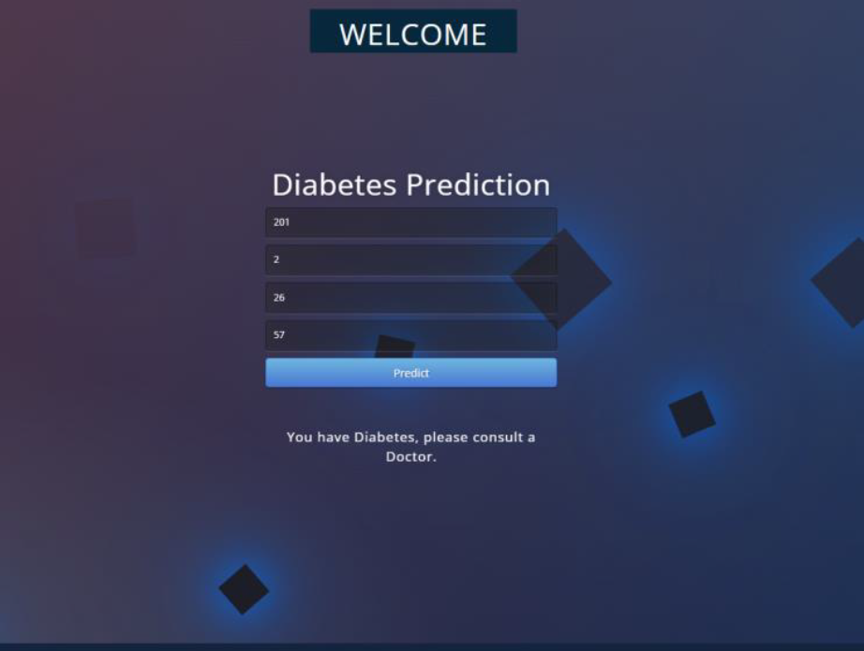
OUTPUT

Slide 15
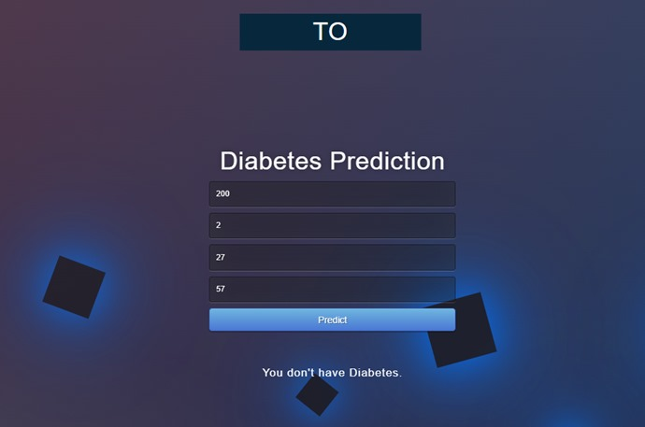
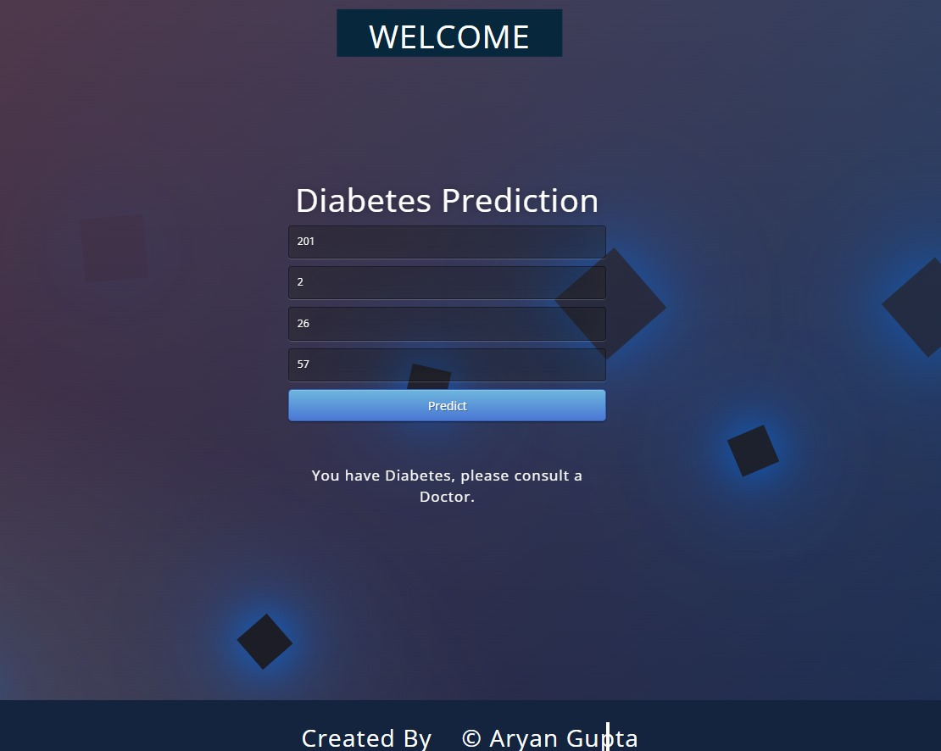
Result Analysis

Slide 16
For diabetes risk:
A BMI above 25.0 is often considered a risk factor for type 2 diabetes, especially when combined with other risk factors such as family history, sedentary lifestyle, and poor dietary habits.
Insulin Levels:
Fasting insulin levels:
Normal range: 5-15 mU/L (milliunits per liter)
Elevated levels may indicate insulin resistance, which is a precursor to type 2 diabetes.
Glucose Levels:
Fasting Blood Glucose Levels:
Normal range: 70-99 mg/dL (milligrams per deciliter)
Prediabetes range: 100-125 mg/dL
Diabetes range: 126 mg/dL or above on two separate testsOral Glucose Tolerance Test (OGTT) (2 hours after consuming a glucose-rich drink):Normal range: Less than 140 mg/dLPrediabetes range: 140-199 mg/dLDiabetes range: 200 mg/dL or above

Slide 17
Conclusion
In this paper machine learning methods are used for the prediction of Diabetic Retinopathy in patients, using their health records of diabetes.
These health records were organized in a structured way by eliminating noisy data. With the help of machine learning algorithms, knowledge is extracted from these records in the form of numerical values for the prediction of DR. Then four types of machine learning models were used to find out the results.
To find out the best parameters for our prediction model and overfitting, two types of validation are applied: Cross Validation and Hold-out validation on our dataset. In this paper, records of 300 patients form our experimental dataset.
In our case, 10 folds and 5 folds cross validations are used. Also, for hold-out validation, we have applied 10% and 20% hold out. Along with this, to improve the algorithmic performance, Principal Component Analysis (PCA) with 6, 7 and 8 principal components has also been tested.

Slide 18
Future Scope
The future scope of involves leveraging advanced research and technology, expanding community outreach, emphasizing preventive health strategies, fostering global collaboration, and investing in research and education initiatives.
By embracing these opportunities, we can enhance diabetes prevention, management, and global health outcomes, paving the way for a future where diabetes is better understood, effectively managed, and ultimately prevented.

Slide 19
References
Medical journals like JAMA, The Lancet, and Diabetes Care.
studocu.com/in/document/indraprastha-institute-of-information-technology-delhi/computer-sciences-and-applied-mathematics/projectreport-diabetes-prediction/30748724
Academic institutions with research departments focusing on diabetes, such as the American Diabetes Association (ADA).
Books authored by respected experts in the field of endocrinology and diabetes management.
Online resources like Mayo Clinic, WebMD, and Medscape, ensuring they are peer-reviewed and evidence-based.

